Slide 1
RECITATION 6: TNG Optimization
15.774/780 (Fall 2021)

Slide 2
Announcements
Case prep for MAMD due Mon before class
Case prep for WLI due Wed before class
Monday lecture is virtual with Prof. Golrezaei
Notes:
Write formulas on the board before class

Slide 3
Agenda
Shadow prices
Formulating TNG in JuMP
Notes:
Write formulas on the board before class

Slide 4
Shadow Prices
In linear programs, each constraint has a shadow price.
If I could increase right-hand-side by 1 unit…
How much would I improve my objective?
CAUTION: Variables do not have shadow prices.
Shadow prices are for constraints.
Side note: you can’t get shadow prices if decision variables are integer.
Notes:
Write formulas on the board before class

Slide 5
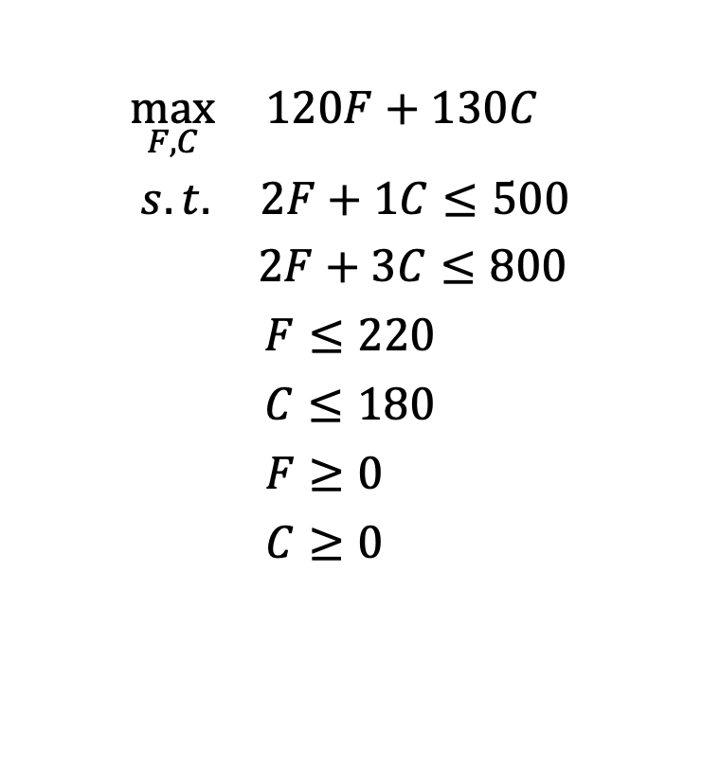
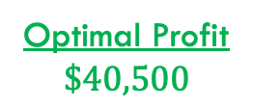
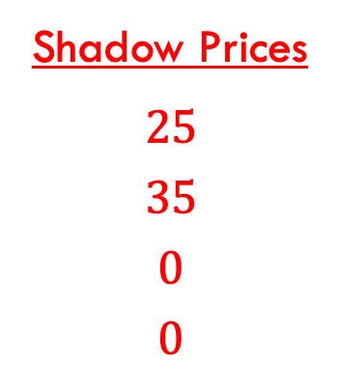

MCU Redux
$$\max_{F,C}{ 120F+130C }$$
$$s.t{. 2F+1C≤500}$$
$$2F+3C≤800$$
$$F≤220$$
$$C≤180$$
$$F≥0$$
$$C≥0$$
Shadow Prices
$$25$$
$$35$$
$$0$$
$$0$$
One more hour of manual assembly would increase my profit by $25.
Optimal Solution
$$F^{∗}=175$$
$$C^{∗}=150$$
Optimal Profit
$$\$40,500$$
Julia
Notes:
Write formulas on the board before class

Slide 6
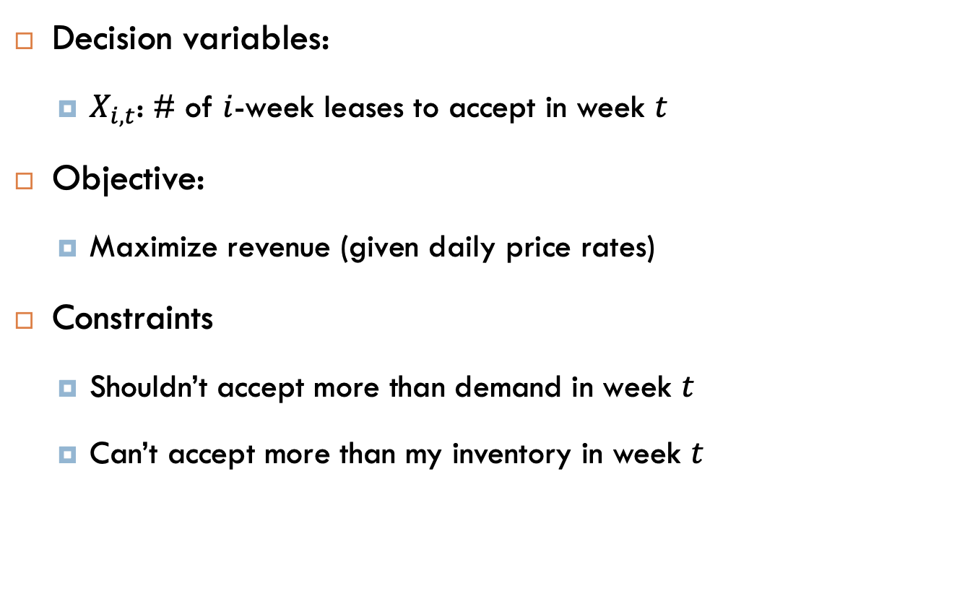
TNG Recap
Decision variables:
$X_{i,t}$: # of $i$-week leases to accept in week $t$
Objective:
Maximize revenue (given daily price rates)
Constraints
Shouldn’t accept more than demand in week $t$
Can’t accept more than my inventory in week $t$
Needed some tricky auxiliary variables and constraints to ensure this.
Notes:
Write formulas on the board before class

Slide 7
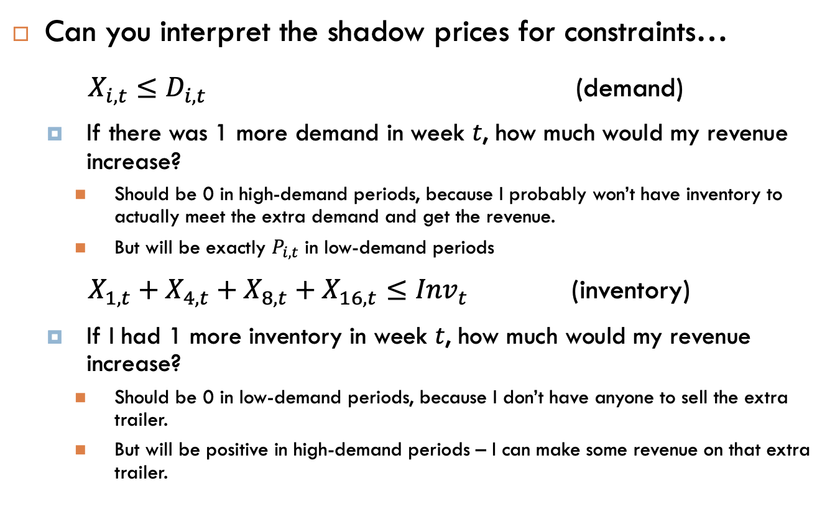
Shadow Prices in TNG:
Can you interpret the shadow prices for constraints…
$X_{i,t}≤D_{i,t}$ (demand)
If there was 1 more demand in week $t$, how much would my revenue increase?
Should be 0 in high-demand periods, because I probably won’t have inventory to actually meet the extra demand and get the revenue.
But will be exactly $P_{i,t}$ in low-demand periods
$X_{1,t}+X_{4,t}+X_{8,t}+X_{16,t}≤{Inv}_{t}$ (inventory)
If I had 1 more inventory in week $t$, how much would my revenue increase?
Should be 0 in low-demand periods, because I don’t have anyone to sell the extra trailer.
But will be positive in high-demand periods – I can make some revenue on that extra trailer.
Notes:
Write formulas on the board before class

